Slide 1

Pac-man with Unity ML-Agents Toolkit
Baioni Francesco
Caprari David
Cingolani Cristian
Notes:
Interlinea + Numeri di pagina

Slide 2
Topics
01 Objective
02 Tools
03 Process & Challenges
04 Main Classes
Observations
Rewards
05 AI
06 Results
07 Conclusions

Slide 3
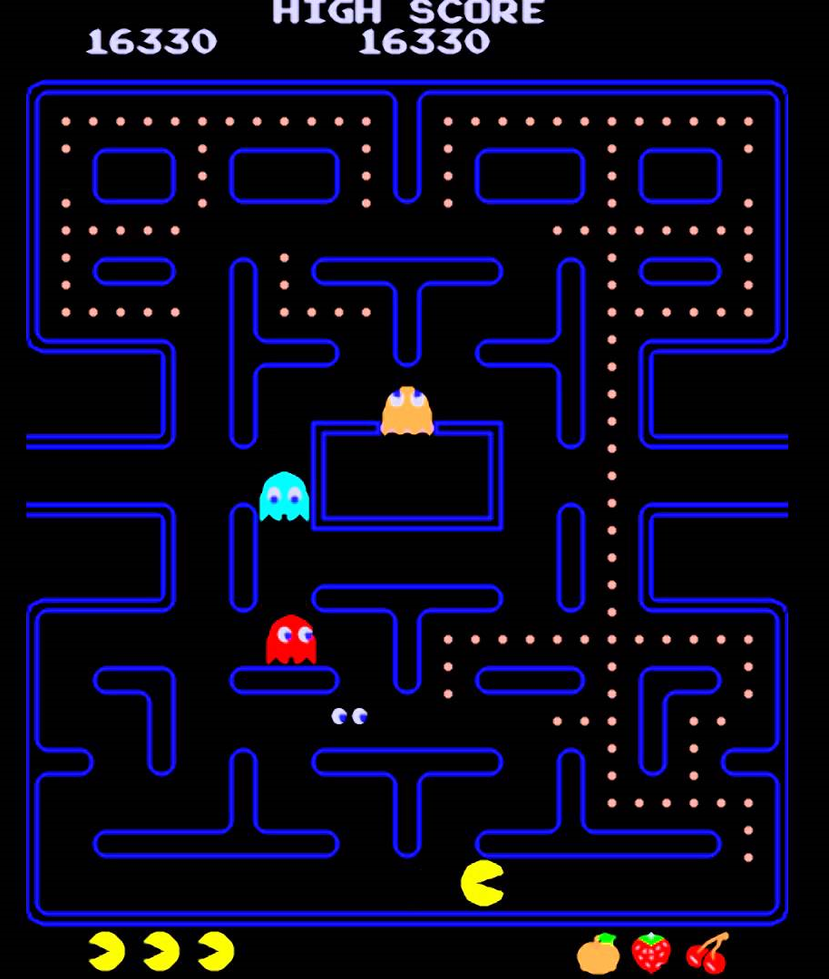
Objective
01
ML-Agents implementation within Pac-man videogame code
Modifying existing code to adapt it to ML-Agents framework
Creation of a class to manage the agent
Choice of training hyperparameters
Make Pac-man agent clever as much as he would be able to complete one level alone

Slide 4



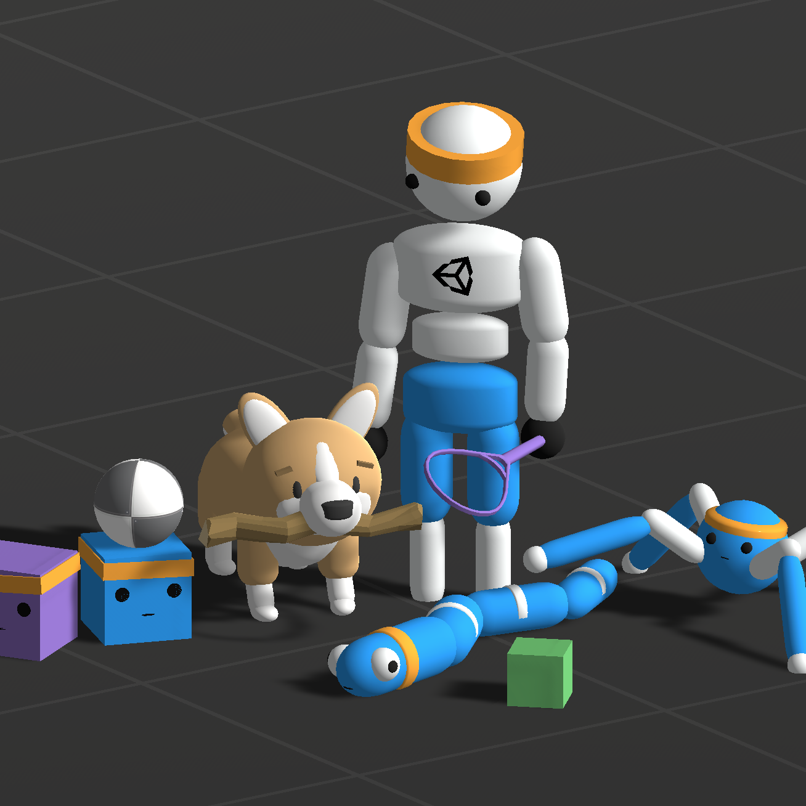

Tools
02
Unity Hub V3.3.0 & Unity Editor 2021.3.9f1
Pac-man code from GitHub
JetBrains Rider 2022.2
ML-Agents framework
Documentation

Slide 5
Process & Challenges
Process & Challenges
03
Iterative Process
High variability of the game with 4 ghosts «moving random»
Minimum changes lead to great differences in results

Slide 6
Main Classes
For Observations
PacmanAgent
For Rewards:
GameManager
PacmanAgent
04

Slide 7
Observations
Pac-man’s position and direction
15% of nearest pellets from all pellets direction vector
Foreach ghost, its position and the distance from Pac-man
Frightened ghosts
Lives

Slide 8
Rewards

Slide 9
PacmanAgent
Negative Rewards
Take Direction Where Aren’t Most Pellets
Near To Ghost (min penalty)
Pac-man In Idle
Inversion
Comes Against Ghost
-0,1
-0,2
-0,02
-0,01
-0,05
-0,2
-0,008
-0,5
-0,8
No Win
Doesn’t Escape In Opposition Of Ghost
Near To Ghost (max penalty)
Turn To a Corner Where There’s No Pellet, While opposed Yes

Slide 10
Positive Rewards
Escape Perpendicularly To Ghost
Turn In Pellets’ Direction
Turn In Direction Where Most Pellets
Free Turn
1,5
1,5
1,5
0,024
0,2
0,5
0,008
0,012
Escape Back From Ghost
Goes Straight
Escape From Ghost 5f Near But Not In NESO Axes
Comes Against Frightened Ghost

Slide 11
Game Manager
Negative Rewards
Positive Rewards
Win
Ghost Eaten
PowerPellet Eaten*
If Distance From Ghosts <= 3f
5
If Distance From Ghosts <= 5f
6
0,006
300
-50
3
If Distance From Ghosts > 5f
-0,5
Lose
Multiplicative Reward If Pellet Eaten (0.006*pelletCount)
*resolved in PacmanAgent.cs

Slide 12
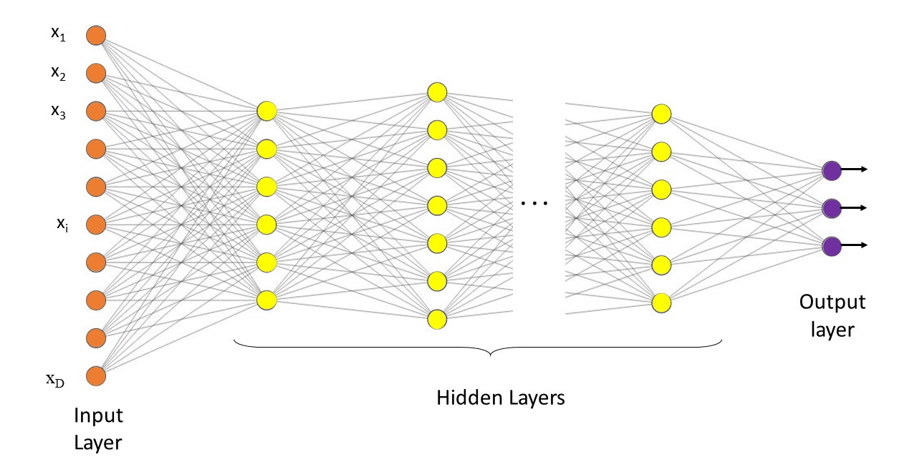
AI
05
PPO
Proximal Policy Optimization
Main Network
256 neurons per FC layer
3 FC layers
Visual encoder: Resnet (Camera Sensor)
Recurrent
Memory (LSTM)
sequence_length = 32
memory_size = 512
Reward
Extrinsic
Curiosity
64 neurons per FC layer
3 FC layers
Behaviour Cloning
Strength = 0.5
Samples_per_update = 2048

Slide 13
Results
06
The following training is the last registered after a series of 15 singular trainings performed. Firstly were kept no ghosts, then added one at each step.
Every adding ghost, two trainings were performed with one life, one with BC the other not, and then another with BC and three lives.
Every BC training is done providing a demonstration of approximately 4 complete games in every given condition (no. of ghosts and lives).
Training objectives required several parameters been changed such as LR, max_steps, whole NN, buffer_size etc.
As the results show, the agent understands the environment in which has been put and the decisions he has to take in order to achieve the goal. Also escaping from ghosts sometimes is well performed but the randomness of the “enemies” is adding too much complexity to the network to train itself.

Slide 14
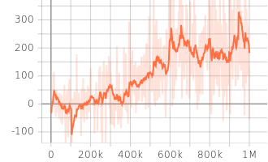
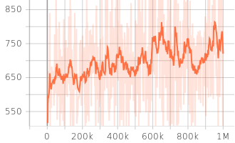
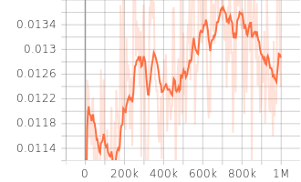
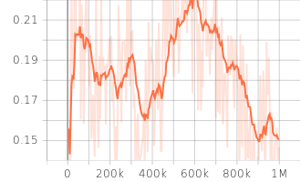
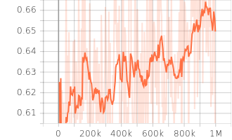
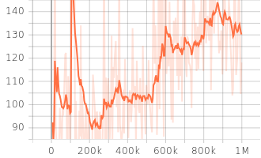
Results
06
Cumulative Reward
Episode Length
Curiosity Forward Loss
Curiosity Inverse Loss
Policy Loss
Value Loss

Slide 15
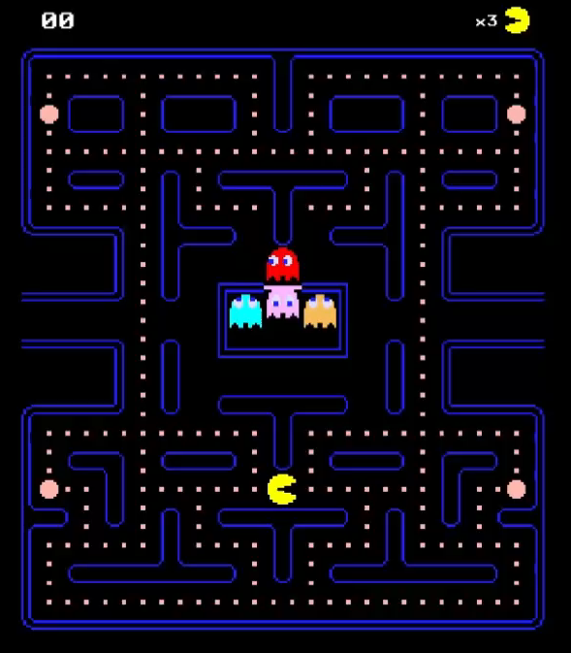
Conclusions
07
With few ghosts, Pac-man is able to achieve quite good results with a quite good rate of wins
More ghosts present, more complexity added to the training phase of the network due to randomness of ghosts’ movements
Imitation learning gives an high power-up to the training, as expected
Automation of escape movement from ghosts can increase performances

Slide 16
Thanks for listening!

